Slide 1

LEAF CLASSIFICATION USING TENSORFLOW
Presented By
Group 4
Under the Guidance
Mr. rashmi ranjan sahoo
Assistant professor(cse department)

Slide 2
CONTENTS
INTRODUCTION
RELATED WORK
TENSORFLOW
CNN
MODELS
DATASET
TRAINING
BOOTSRAP AND FLASK
WEBAPP
CHALLENGES
CONCLUSION
FUTURE WORK
REFERENCE

Slide 3
INTRODUCTION
This project involves classifying images of leaves on a web-application.
This introduction provides a discussion of the project specification. It also gives the high level overview of the project.
It also provides a roadmap for the viewer about the overall presentation and structure of the report.

Slide 4
SPECIFICATION AND OVERVIEW
The goal of this project is to classify the leaf images. The project started with lot of challenges and we have discussed every challenges faced and how we overcome those and all the different technologies used while designing the project.
Technologies used:-
Python
Tensorflow
Bootstrap
HTML
Flask web framework

Slide 5
PROBLEM STATEMENT AND CHALLENGES
The problem here is the classification of leaves, although lot of models have been devised till date to classify other things and one of the most common among them is the classification of dog and cat.
But classifying leaves is one of the difficult task because of the difficulty of collecting dataset. Even if the dataset is collected the model accuracy is very low.

Slide 6
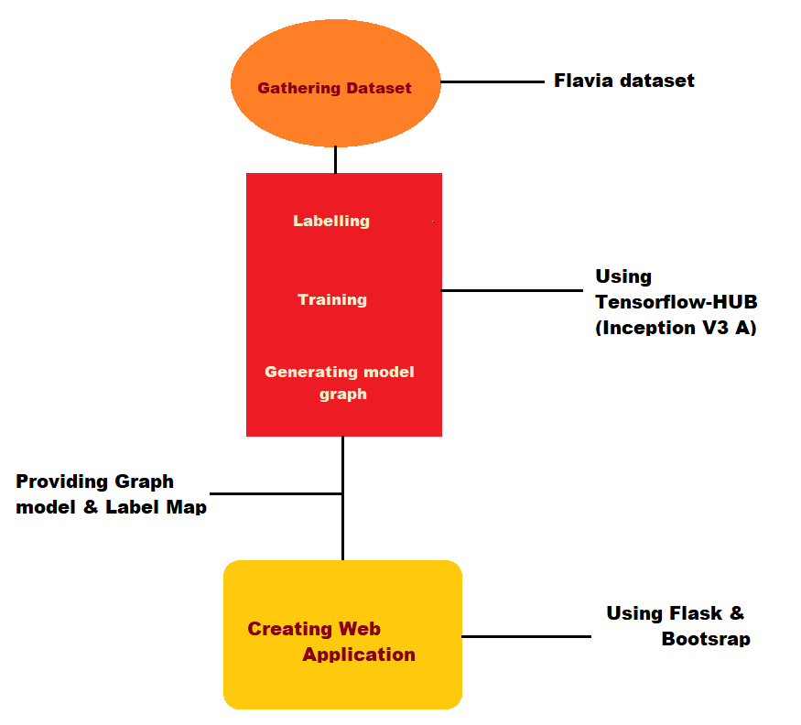
WORKING MODEL

Slide 7
APPLICATIONS OF THIS PROJECT
One of the application of Leaves classification is in the field of agriculture and can also be used by common people to classify the plants that grow in home.
One of the advantages of this project is that it tells the probability with which the image is classified.

Slide 8
RELATED WORK
There has been lot of related work in leave classification. However, they can’t be labelled perfect.
Google lens is one of the application of leaf classification where the user captures image of a leaf and then google classifies it and shows the class to which the Leaf belongs and other links related to that class.
But one of the disadvantages of the google lens is that it doesn’t provides the user with the probability of the result.
Model that can be used:-
Inception V3
Nasnet
Mobilenet V1
Mobilenet V2

Slide 9
TENSORFLOW
TensorFlow is an open source software library for dataflow programming across a range of tasks.
It is a symbolic math library, and is also used for machine learning applications such as neural networks. It is used for both research and production at Google.‍
It helps in building and train ML models easily using intuitive high-level APIs.
Applications of Tensorflow:-
Image search, Motion detection, Machine vision and photo Clustering.
Text based applications such as sentimental analysis, Threat detection and Fraud detection.
One of the most well-known uses of Tensorflow are sound based applications.

Slide 10
TENSORFLOW-HUB
What is Tensorflow-hub?
Tensorflow-HUB is a library for reusable machine learning modules.
It is used for the publication, discovery, and consumption of reusable parts of machine learning models.
A module is a self-contained piece of a Tensorflow graph, along with its weight and assets, that can be reused across different tasks in a process known as transfer learning.
Transfer learning:-
Transfer learning is research problem in machine learning that focuses on storing knowledge gained while solving one problem and applying it to a different but related problem.
For example, knowledge gained while learning to recognize cars could apply when trying to recognize trucks. In sort this learning can:
Train a model with a smaller dataset,
Improve generalization, and
Speed up training

Slide 11
CONVOLUTIONAL NEURAL NETWORK
A convolutional neural network (CNN, or ConvNet) is a class of deep, feed- forward artificial neural network, most commonly applied to analyzing visual imagery .
CNNs use a variation of multilayer perceptrons designed to require minimal preprocessing .
They are also known as shift invariant or space invariant artificial neural networks (SIANN), based on their shared-weights architecture and translation invariance characteristics .
A CNN typically consists of 3 types of layers:
Convolution Layer
Pooling Layer
Fully Connected Layer

Slide 12
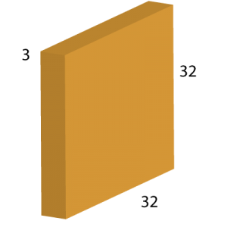
CONVOLUTION NEURAL NETWORK
Convolution Layer
Since convolution layers form the crux of the network, I’ll consider them first. Each layer can be visualized in the form of a block or a cuboid .

Slide 13
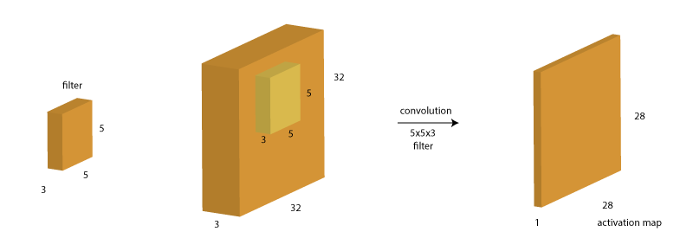
CONVOLUTION NEURAL NETWORK
Now a convolution layer is formed by running a filter over it. A filter is another block or cuboid of smaller height and width but same depth which is swept over this base block. Let’s consider a filter of size 5x5x3.

Slide 14
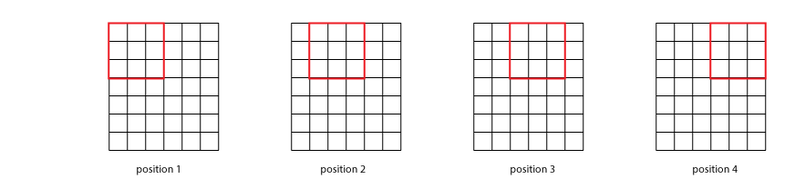
CONVOLUTION NEURAL NETWORK
Since depth is same, we can have a look at the front view of how filter would work .

Slide 15
CONVOLUTION NEURAL NETWORK
Let’s define a generic case where image has dimension N*N*d and filter has F*F*d. Also, lets define another term stride (S) here which is the number of cells (in above matrix) to move in each step. In the above case, we had a stride of 1 but it can be a higher value as well. So the size of the output will be:
output size = (N – F)/S + 1
Let’s consider an example to consolidate our understanding. Starting with the same image as before of size 32×32, we need to apply 2 filters consecutively, first 10 filters of size 7, stride 1 and next 6 filters of size 5, stride 2. Before looking at the solution below, just think about 2 things:
What should be the depth of each filter?
What will the resulting size of the images in each step.

Slide 16
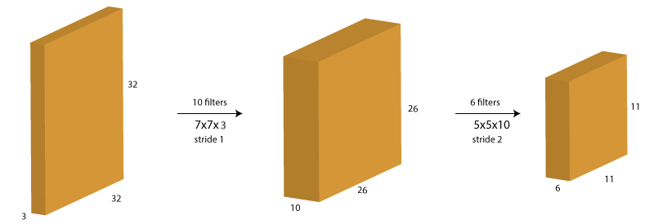
CONVOLUTION NEURAL NETWORK

Slide 17
CONVOLUTION NEURAL NETWORK
Pooling Layer
When we use padding in convolution layer, the image size remains same. So, pooling layers are used to reduce the size of image. They work by sampling in each layer using filters.
Fully Connected Layer
At the end of convolution and pooling layers, networks generally use fully-connected layers in which each pixel is considered as a separate neuron just like a regular neural network. The last fully-connected layer will contain as many neurons as the number of classes to be predicted .

Slide 18
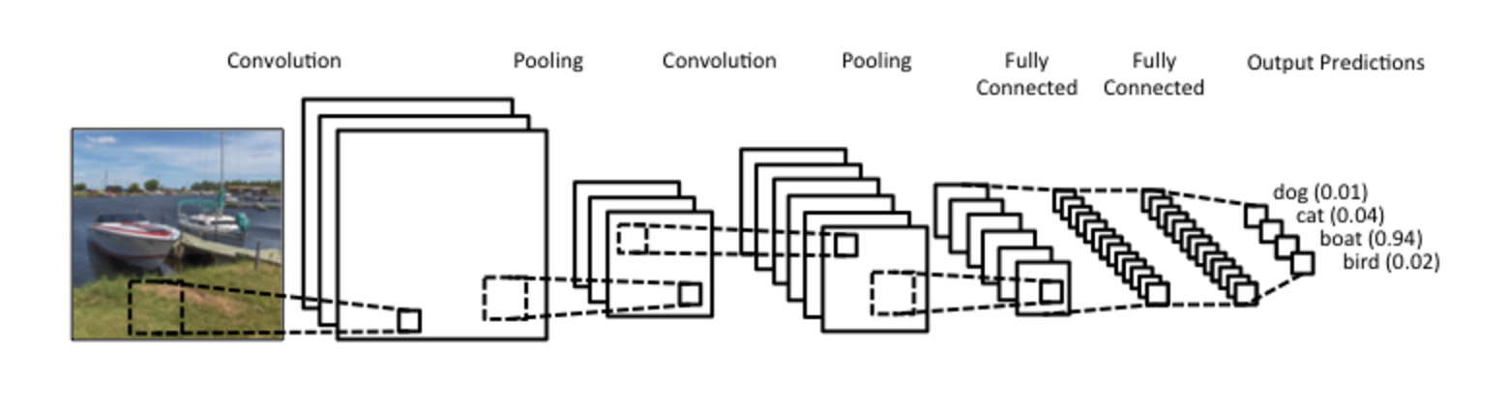
CONVOLUTION NEURAL NETWORK

Slide 19
Image Feature Extraction Models
There are many architecture of CNN/RNN which uses transfer learning:
NASNet
MobileNet V1
MobileNet V2
Inception V3

Slide 20
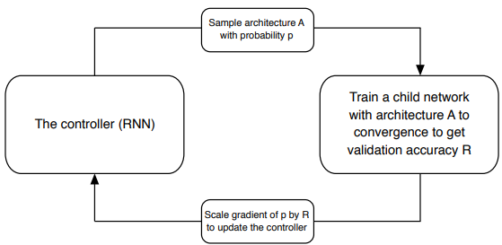
NASNet
On ImageNet image classification, NASNet achieves a prediction accuracy of 82.7% on the validation set
The goal of NAS is to use a data-driven and intelligent approach to constructing the network architecture instead of intuition and experiments.
In NAS, a controller recurrent neural network (RNN) samples child networks with different architectures

Slide 21
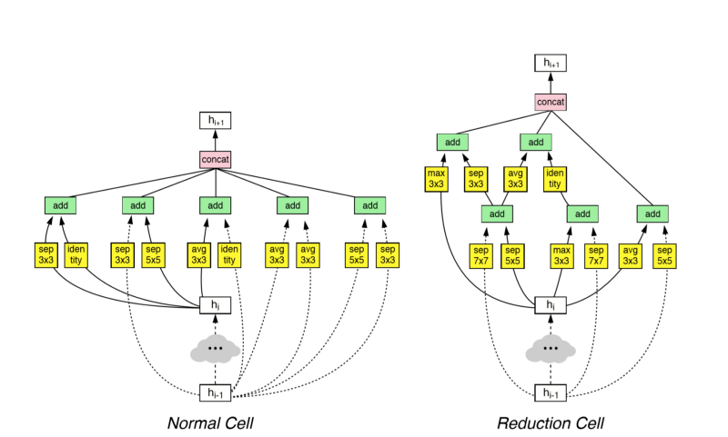
NASNet
Normal Cell: Convolutional cells that return a feature map of the same dimension
Reduction Cell: Convolutional cells that return a feature map where the feature map height and width is reduced by a
factor of two

Slide 22
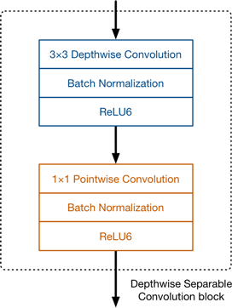
Mobilenet V1
In MobileNet V1 Depthwise Separable Convolution is used to reduce the model size and complexity.
It is particularly useful for mobile and embedded vision applications.

Slide 23
Mobilenet V1
The full architecture of MobileNet V1 consists of a regular 3 X 3 convolution as the very first layer, followed by 13 times the depthwise separable blocks.
There are no pooling layers in between these blocks.
Activation function: ReLU6 (ReLU6 is more robust than regular ReLU when using low-precision computation.)
Mobilenet V1 apply the feature depth percentage to the bottleneck layer, which make the job of the classification layer harder for small depths.

Slide 24
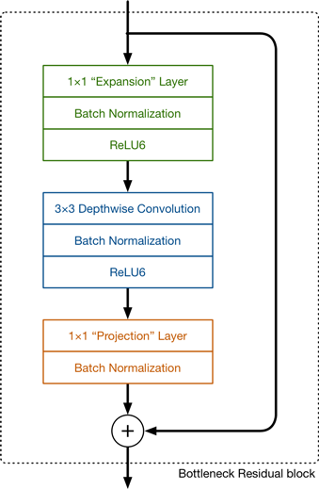
Mobilenet V2
MobileNet V2 uses depthwise separable convolutions with three convolutional layers in the block.

Slide 25
Mobilenet V2
The architecture of MobileNetV2 contains the initial fully convolution layer with 32 filters, followed by 19 residual bottleneck layers
No pooling Layers.
Activation function: ReLU6.
In V1 the pointwise convolution either kept the number of channels the same or doubled them. In V2 it does the opposite: it makes the number of channels smaller.

Slide 26
Inception V3
Inception v3 is a widely-used image recognition model that has been shown to attain greater than 78.1% accuracy on the ImageNet dataset.
The network is 42 layers deep and can classify images into 1000 object categories.
Inception V3 consist of convolutions, average pooling, max pooling, concats, dropouts, and fully connected
layers.

Slide 27
Inception V3
Features of Inception v3:
Factorizing Convolutions
Auxiliary Classifiers
Efficient Grid Size Reduction
Label Smoothing As Regularization

Slide 28
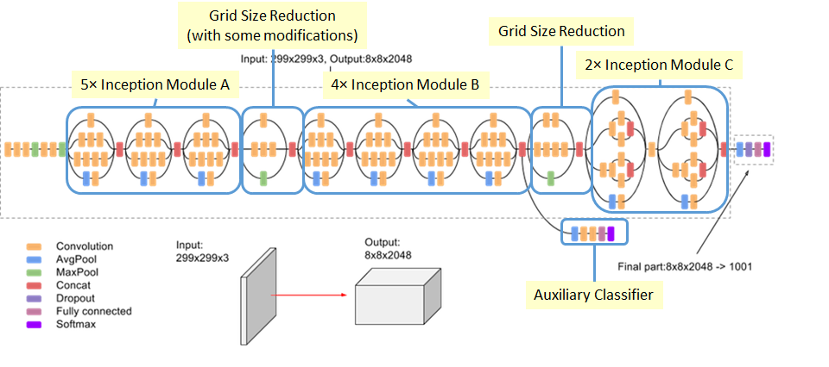
InceptionV3

Slide 29
Inception V3
In our project we have used Inception V3 architecture for image feature extraction.
Inception V3 provides high accuracy results with moderate running time for the retraining script. It is also provide more accuracy than any other module when the dataset is high
MobileNet v1 and MobileNet v2 is used for mobile based devices so it is able provide results effciently if the number of domain(less data) is less.
NASNet which could gives some extra precision but takes much training time.

Slide 30
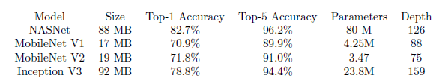
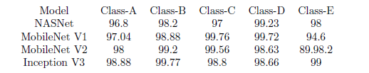
Comparision:
During ImageNet competition some of the transfer learning models where used and they showed below results:
When implementing these models on our leaf dataset, these results where found out while training the model taking 4000 steps. And here the class represents the plants we took to test.

Slide 31
DATASET
The dataset was collected from internet which contains 31 different class of leaves, the dataset was made by a group of researchers in 2007 for their algorithm.
The dataset contained lot of images of leaves belonging to different class and then we sorted out the dataset and arranged them folder wise so that it can later be feed into our training module.
The training module takes the dataset as folders where each folder is named as the class name to which the leaf belongs. In the dataset used we roughly had 40-50 images in each class and each image is assigned a random 4 digit number.

Slide 32
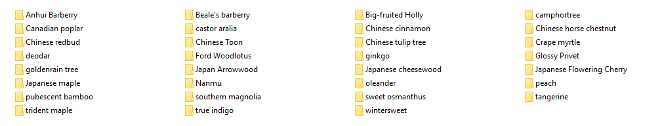
DATASET
The dataset after putting all the images into their respective class folder looks like this:-

Slide 33
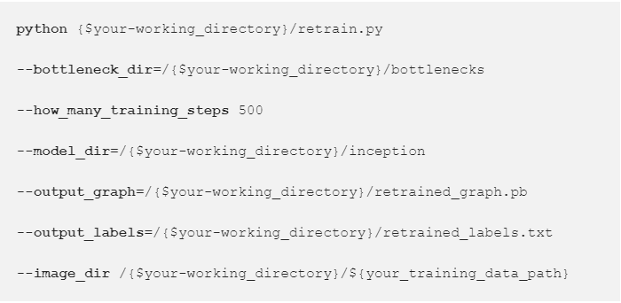
TRAINING
At first, get the latest sample code from git TensorFlow repo.
curl –L0 https://github.com/tensorflow/hub/raw/master/examples/image_retraining/retrain.py
For training, type the following command by invoking python:

Slide 34
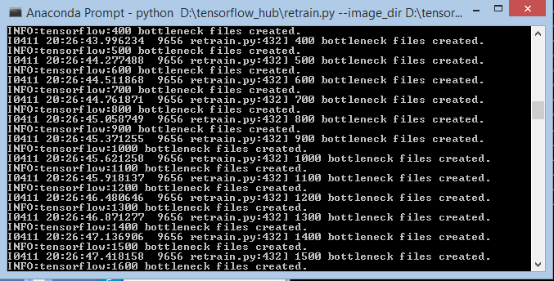
BOTTLENECK
'Bottleneck' is an informal term used for the layer just before the final output layer that actually does the classification. (TensorFlow Hub calls this an "image feature vector"). An image feature vector is a dense 1-D tensor that represents a whole image, typically for classification by the consumer model.

Slide 35
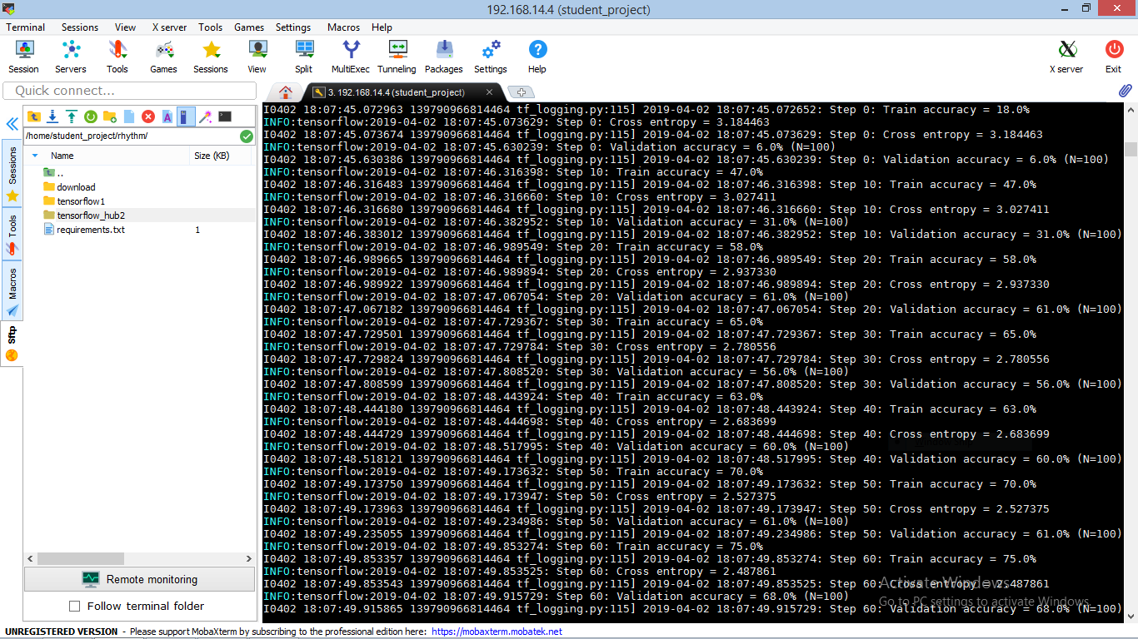
After the bottlenecks training is over, the final layer gets trained and we will see a series of step outputs, each one showing training accuracy, validation accuracy, and the cross entropy.

Slide 36
The training accuracy shows what percent of the images used in the current training batch were labeled with the correct class.
The validation accuracy is the precision on a randomly-selected group of images from a different set.
Cross entropy is a loss function which gives a glimpse into how well the learning process is progressing.

Slide 37
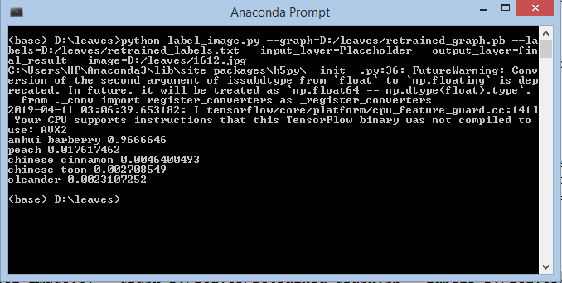
USING THE RETRAINED MODEL
curl –LO
https://github.com/tensorflow/tensorflow/raw/master/tensorflow/examples/label_image/label_image.py python label_image.py \ --graph=/tmp/output_graph.pb --labels=/tmp/output_labels.txt \ --input_layer=Placeholder \ --output_layer=final_result \ --image test1.jpg

Slide 38
BOOTSTRAP
What is Bootstrap?
It is one of the popular frameworks for creating layouts of a webpage. Some of the reasons for using Bootstrap is:-
The responsive CSS adjusts to mobile, tablets, and Desktop
Its compatibility with all the popular browsers.
Easy to set up and use to develop web pages.

Slide 39
BOOTSTRAP
How to use Bootstrap?
To use bootstrap one just need to visit the Documentation page of the official website of Bootstrap, mentioned in the References.
Copy the basic template in the ‘.html’ file and start choosing the components and different elements required from the documentation too.

Slide 40
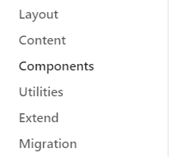
BOOTSTRAP
The different elements can be found in the left hand side of the documentation, where one can browse through what they want and then copy the code into their HTML file.

Slide 41
BOOTSTRAP
How Bootstrap is responsive?
In the starter/basic template of bootstrap there is a meta tag like:-
<meta name="viewport" content="width=device-width, initial-scale=1, shrink-to-fit=no">
The above meta tag allows the Boorstrap layouts to be responsive.
One can also find fully prepared websites and blogs by BootStrap in the official website.

Slide 42
FLASK
What is Flask?
Flask is a micro web framework by python which let’s developer to develop webpages using python as Backend.
Installation:-
pip install flask
Using flask we can set up a webapp by using templates written in HTML.

Slide 43
FLASK
The flask project contains a python file which is used to run the web-application.
The python file contains some imports and then the app route and a final function call to run the web-application.
Flask creates a local server on which the project is executed while at the development phase.

Slide 44
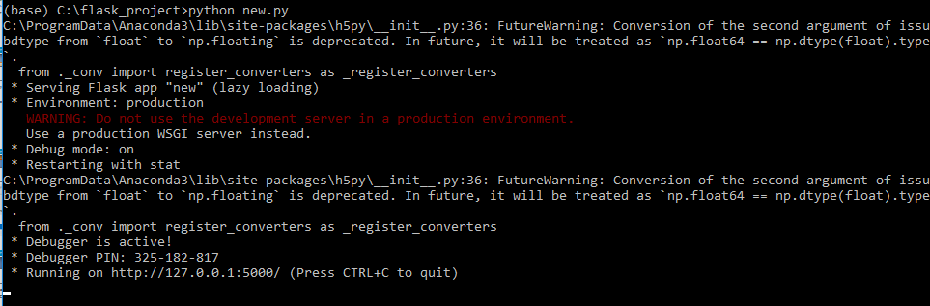
FLASK
To run the web-application, one just need to go to the project directory in the command prompt and then execute the following command:-
python filename.py
After executing the command the command prompt will indicate that the server has been started and the webapp can be viewed there.

Slide 45
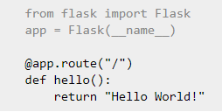
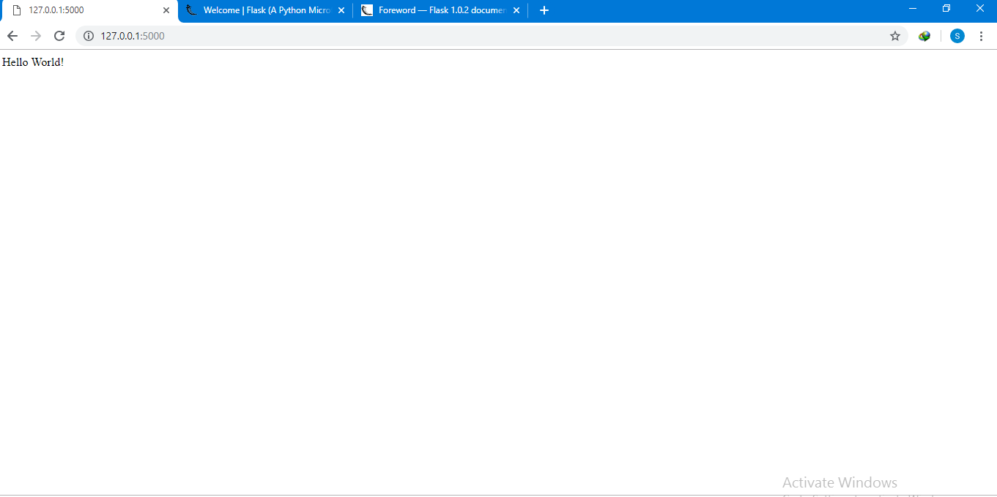
FLASK

Slide 46
WEB-APPLICATION
The web-application was developed using Flask web framework.
For now, the web-application is locally available.
The templates i.e. all the HTML files are hardcoded and only the CSS part is taken from Bootstrap.
The backend is based on execution of a python program.
The web-application takes as input one image file of a leaf that is later sent to a python code that classifies the image and the code returns the class to which the leaf belongs by inferencing from the generated model and the result is then displayed in another webpage along with the probability.

Slide 47
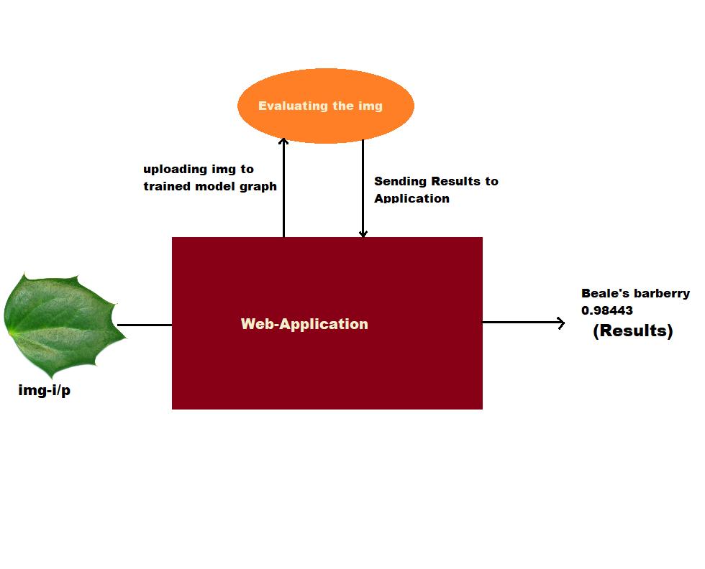
WEB-APPLICATION
How the Web-application works?
Uploading image
Processing it
Showing the result

Slide 48
WEB-APPLICATION
Code and templates:-
New.py:-
Main python program where all the backend work is happening and it also lays the pipeline of the webapp. It is one of the most important code.
Config.json
This file contains parameters.
The need of this file is that, if someone wants to use our project in a different system and wants to modify location and other variables then it can be done easily just by changing it in this json file.
Static folder:-
This is the folder where the images uploaded by the users are stored and then the python code in the backend uses the file to classify.

Slide 49
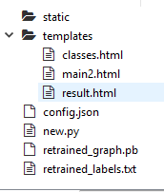
WEB-APPLICATION
Templates folder:-
This folder consists of all the html files that are used in the web-application.
main2.html, result.html, classes.html
Retrained_graph.pb:-
This is the inference graph that was generated during the training phase to classify images.
Retrained_labels.txt:-
This text file contains the list of classes on which we have trained the model.

Slide 50
WEB-APPLICATION
How the web-application works?
The web-application starts with a Homepage where the user can input an image and after clicking on “Submit”, the image gets saved locally in the computer.
After submitting the image, a python file executes which then reads the image file and passes it to the function where inference has to be done.
The next page also known as the result page shows the image uploaded by the user and also the classification along with the probability.

Slide 51
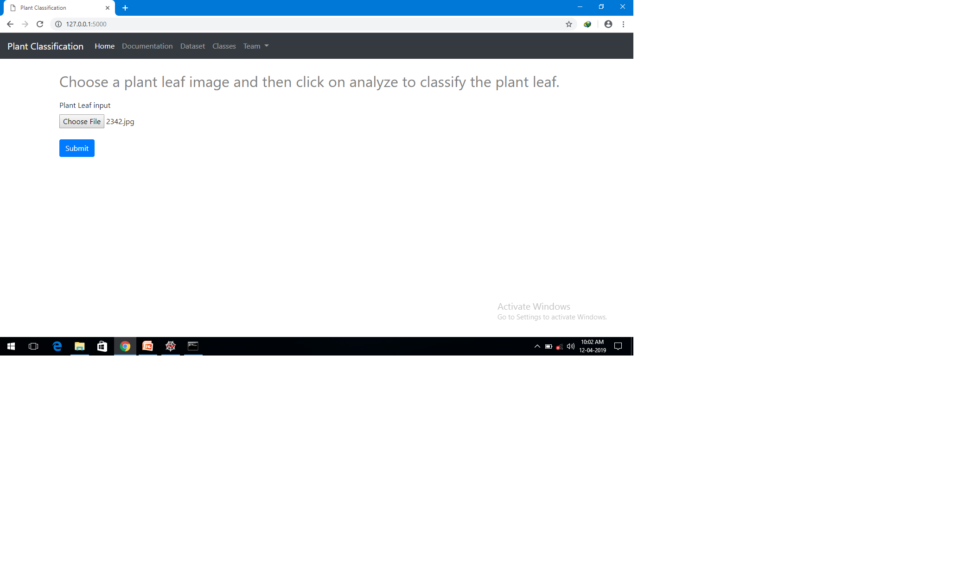
WEB-APPLICATION

Slide 52
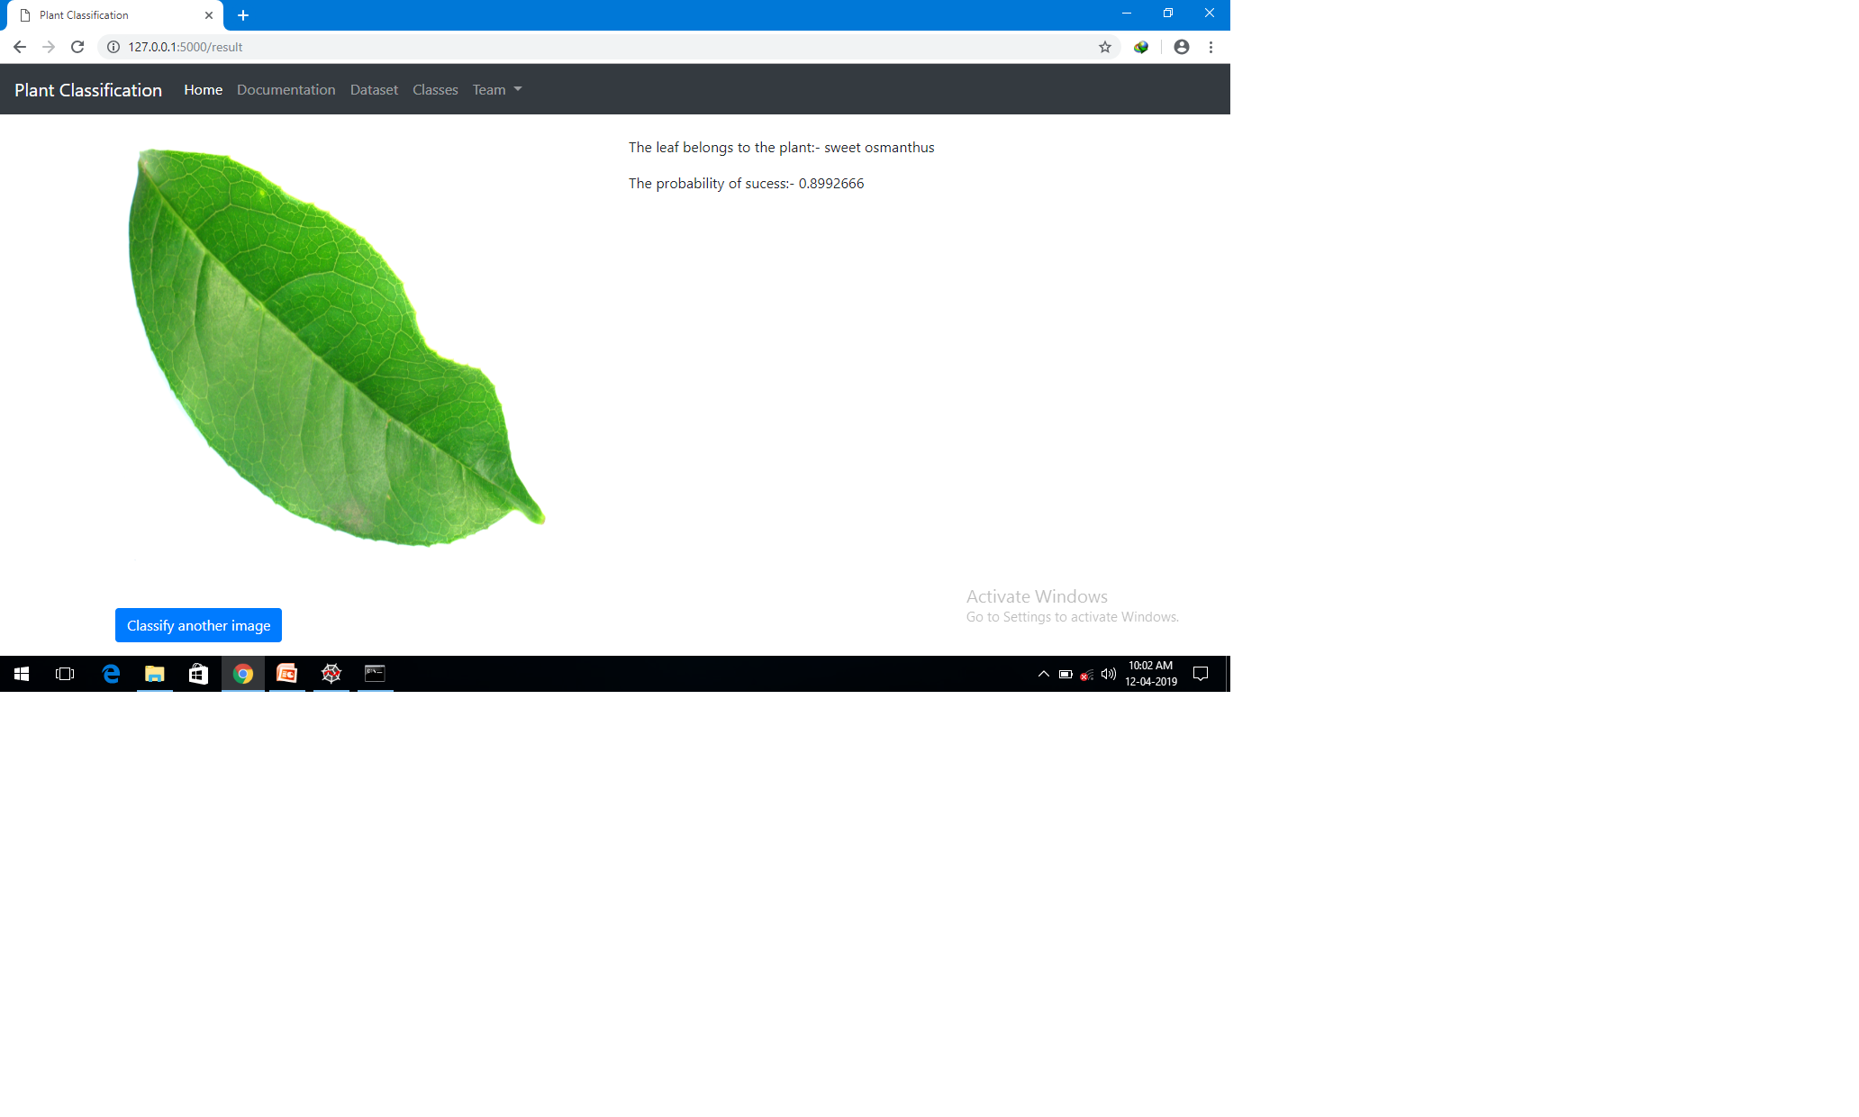
WEB-APPLICATION

Slide 53
WEB-APPLICATION
Why Flask?
Easy and straightforward
Ability to handle ML models
Not complicated as compared to other python web frameworks
Documentation is simple and easy to understand
Provides a local server for the development phase.

Slide 54
CHALLENGES
One of the challenge of this project is to collect the dataset of the leaves , there are very few dataset available on the net and collecting a huge dataset with a limited members in the team is not an easy task.
Another challenge is the hardware requirements, since we are using tensorflow and it works on AVX instruction which require a high spec computer with a high performance GPU, which is not available easily to all. Although we generated the model to classify the leaves but still the time complexity is not that low. It takes considerable time to give the classification to the user.

Slide 55
CONCLUSION
An accurate and efficient image classification has been developed.
This project uses recent techniques in the field of deep learning and neural network.
Custom dataset was made available through the internet whose link is provided in the references.
The above project can be used by farmers and common people to classify leaves images. In this project we are classifying leaves from 30 classes because of the limited size of dataset.

Slide 56
FUTURE WORK
This project can be improved by increasing the number of classes of plants and also by increasing the number of images and that will increase the accuracy and precision of the model.
One more thing that can be done is the real time detection of plant leaves, this is a bit difficult for now because the real time detection includes labelling the images in dataset which is not an easy task for a small group but with some improved labelling techniques this can be done more precisely in the future and then we might be able to detect the leafs and the plants easily.

Slide 57
REFERENCE
[1] http://flavia.sourceforge.net/
[2] http://flask.pocoo.org/
[3] https://getbootstrap.com/docs/4.3/getting-started/introduction/
[4] https://www.tensorflow.org/hub/tutorials/image_retraining
[5] Convolutional Nueral Networks(LeNet) – DeepLearning 0.1 documentation” . Deeplearning 0.1. LISA Lab.
[6] https://www.tensorflow.org/overview
[7] Stephen Gang Wu, Forrest Sheng Bao, Eric You Xu, Yu-Xuan Wang, Yi-Fan Chang and Chiao-Liang Shiang, A Leaf Recognition Algorithm for Plant classification Using Probabilistic Neural Network, IEEE 7th International Symposium on Signal Processing and Information Technology, Dec. 2007, Cario, Egypt
Page no.33

